Slide 1
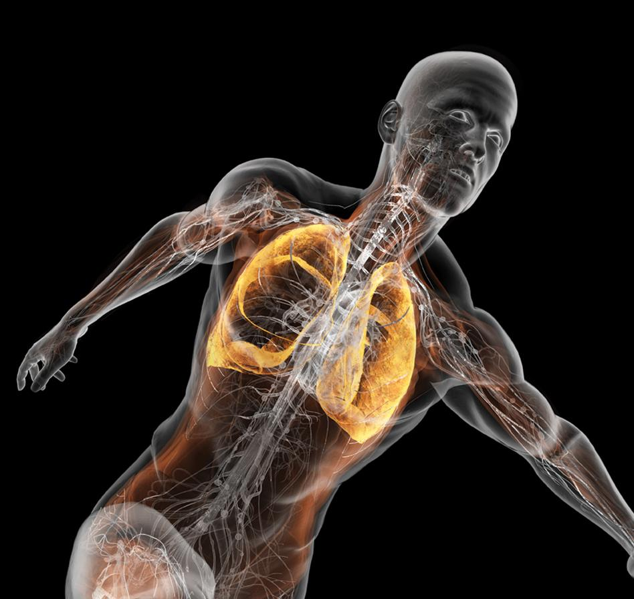
Using Sports Genetics for Personalized Medicine in Athletes
"There is likely a minimal set of physical traits or genetic makeup which facilitates achievement to a particular level of success, but I do not believe that genetics are necessarily an absolute limiter of exceptional performances."
Peter Vint (2011)
High Performance Director for the United States Olympic Committee
Illustration by Bryan Christie
Andrew Roos
Stanford Sports Genetics Project
https://sportsgenetics.stanford.edu

Slide 2
Rationale and motivation for personalized medicine applied to athletes
1) Health: 30-75% of distance runners [1] & up to 75% of triathletes [2] are injured each year.
2) Success: 0.03% (2 seconds) of the total race time separated the 3 medalists in the Women’s Triathlon at the 2012 London Olympics [3].
3) Money: 100,000-250,000 ACL reconstructions per year, costing $1.7 to $6.25 billion in direct healthcare costs [4].
4) Business: As of July 25th 2013 there were 159 MLB players on the DL, accounting for $602 million in salaries or 18.9% of the total MLB payroll [5].
1: van Gent, R.N., et al., British journal of sports medicine, 2007. 41(8): p. 469-80; discussion 480.
2: Egermann, M., et al., International journal of sports medicine, 2003. 24(4): p. 271-6.
3: http://www.london2012.com/triathlon/event/women/phase=trw001100/index.html
4: Hewett et al., British journal of sports medicine, 2010. 44: p. 848-855.
5: “Money on the Bench”, New York Times,
http://www.nytimes.com/interactive/2013/05/13/sports/baseball/money-on-the-bench.html

Slide 3
Rationale and motivation for personalized medicine applied to athletes
Empower athletes
  knowledge is power and might provide an advantage
  small details can be the difference between winner or loser
Build a research database
  athletes are valuable research subjects for the sports medicine community
  physicians/scientists can find new genes associated with injury & sports performance
Sports genetics field
  first of its kind program at Stanford

Slide 4
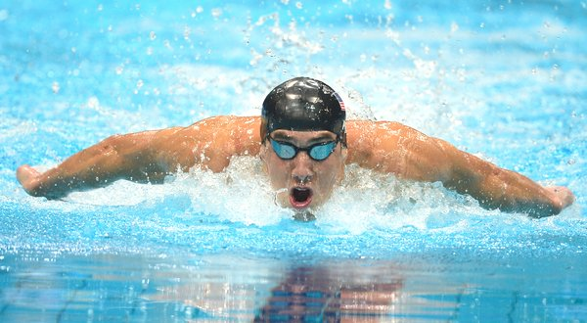
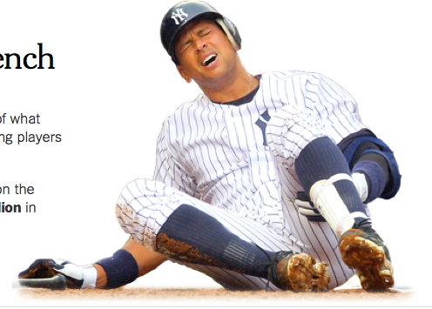
Sports Genetics = Performance + Injury

Slide 5

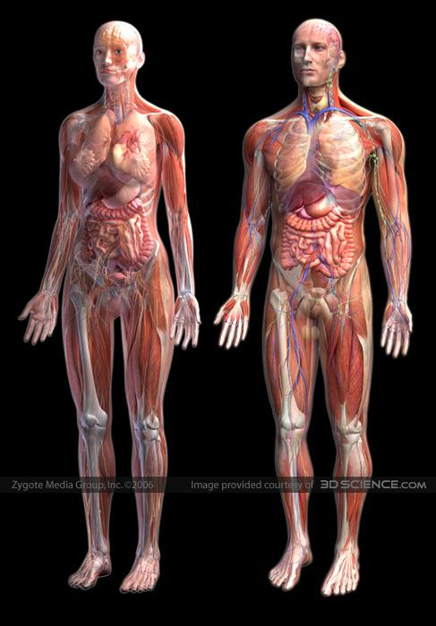

Genetic factors
illustration from 3dscience.com
Usain Bolt
- gender
- ancestry & ethnicity
- anatomy
- biomechanical factors
- muscle fiber types
- muscle elasticity
- soft-tissue strength
- fatigue resistance
- training adaptation
- recovery ability
- injury resistance

Slide 6
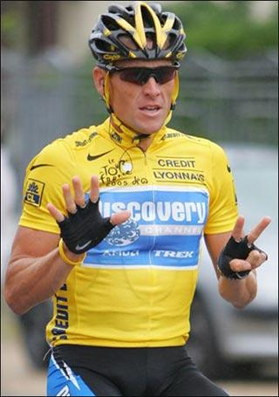
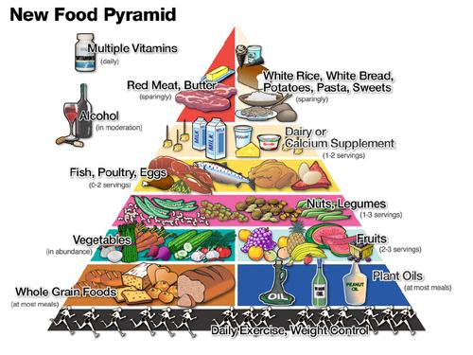
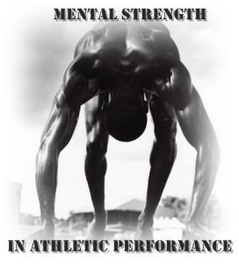
Environmental factors
Lance Armstrong
US Department of Agriculture
- training/conditioning
- age
- PED’s
- nutrition
- sleep
- recovery
- mental strength
- work ethic
- psychology

Slide 7
Genetics vs. Environment
- Heritability of “athlete status” is estimated at 66% [1]
- Heritability of VO2max, lactate threshold and running economy is ~50% for each [2]
-Bone mineral density: heritability= 50-85%, genetics can explain 6% of the variance (67 SNPs)
-Osteoarthritis: heritability= 50-63%
-Vitamin D: heritanbility= ~53%, genetics can explain 1-4% of the variance (6 SNPs)
De Moor MH, et al. (2007). Twin Res Hum Genet 10: 812–820.
Bouchard TJ (1986, 1998, 1999). Minnesota Twin Family Study.

Slide 8
Sports Genetics = Performance + Injury

Slide 9
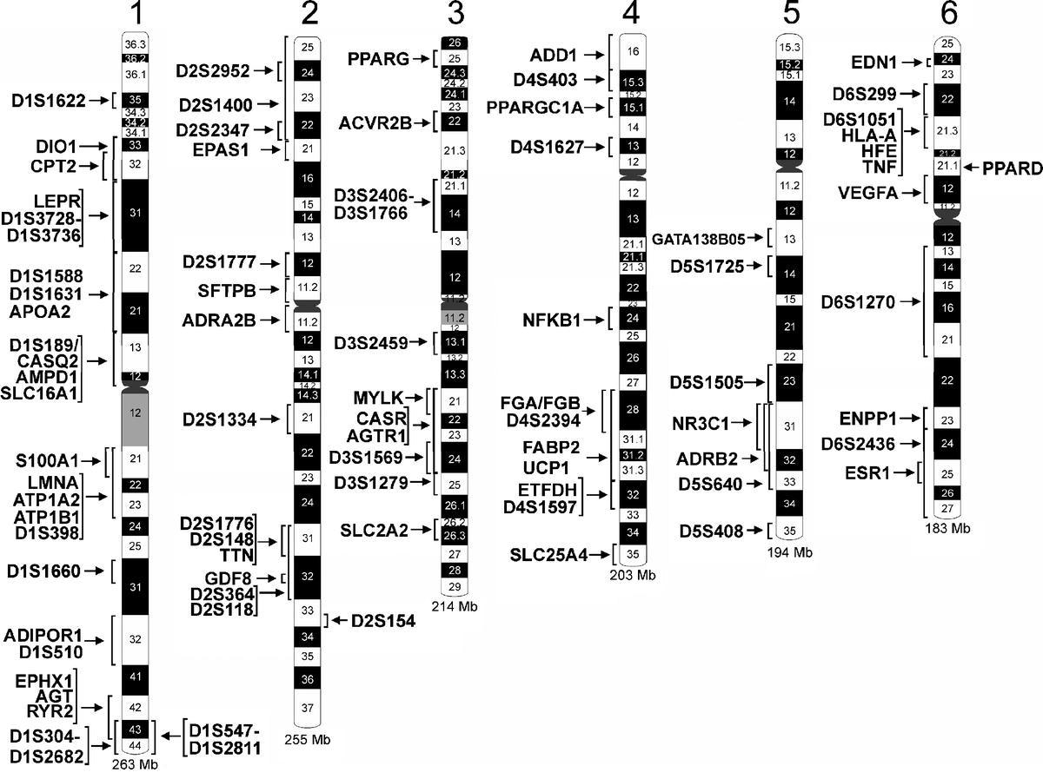
The Human Gene Map for Performance and Health-Related Fitness Phenotypes
239 gene entries:
214 autosomal
7 on X
18 mitochondrial
Bray et al., Med Sci Sports Exerc, 2010. 41: 35-73.

Slide 10
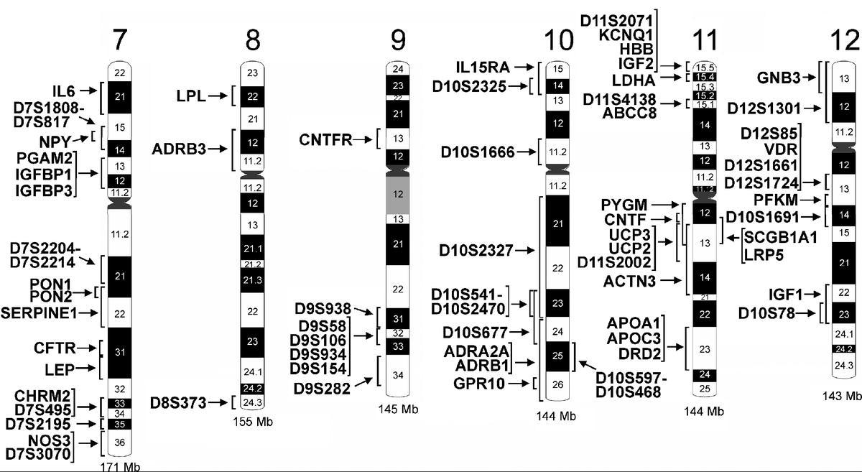
Bray et al., Med Sci Sports Exerc, 2010. 41: 35-73.

Slide 11
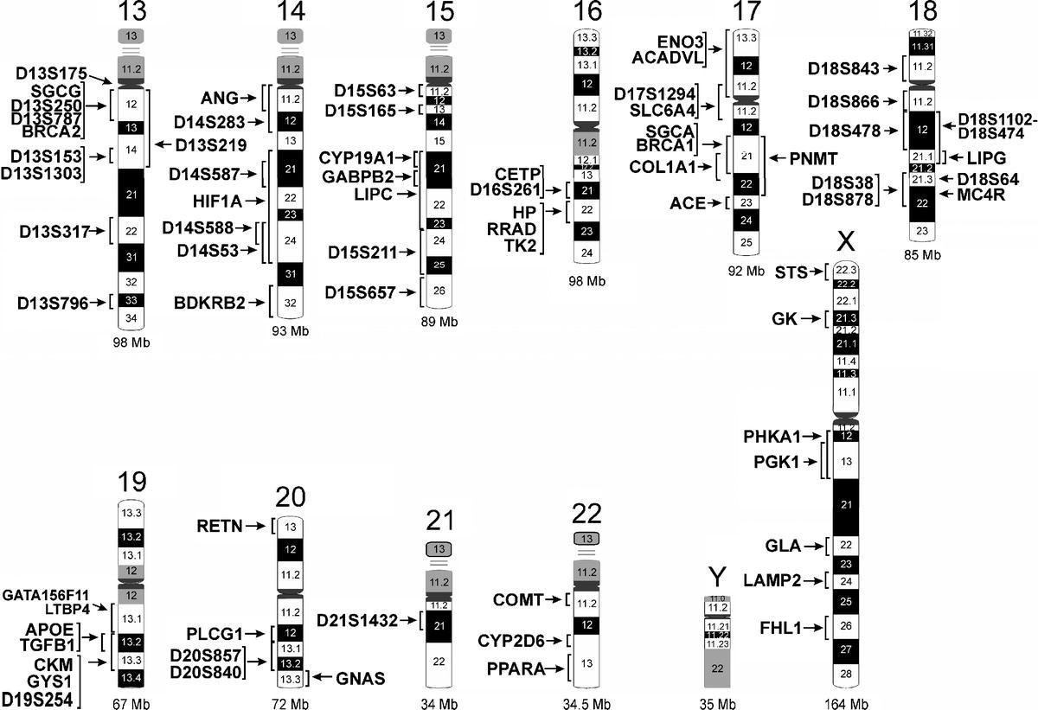
Bray et al., Med Sci Sports Exerc, 2010. 41: 35-73.

Slide 12
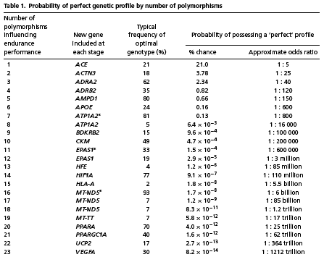
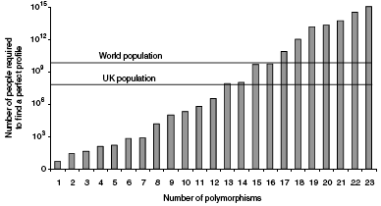
Can there be a perfect endurance athlete? – population distribution of genetic potential
Results = "Using probability calculations, we found only a 0.0005% chance of a single individual in the world having the ‘preferable' form of all 23 polymorphisms."
Williams (2008) J Physiol 586(1):113-21.
the human body works as a "system": if one factor is sub-par, then the whole system loses the capacity to function at optimal performance

Slide 13
Angiotensin I-converting enzyme (ACE)
ACE: angiotensin converting enzyme
- functions= vasoconstriction, salt/water balance, inflammation, RBC synthesis, tissue oxygenation, muscle efficiency
- ACE I/D: I= insertion of 287bp Alu element in an intron 16 of ACE
Europeans: II= 25%, ID= 50%, DD= 26%
Asians: II= 23%, ID= 66%, DD= 11%
- I allele: Alu insertion; lower ACE activity
I/I genotype -> increased endurance performance [OR=2.07, p=0.009]
increased metabolic response from training, metabolic efficiency
- D allele: no Alu insertion; higher ACE activity
D/D genotype -> increased power performance [OR=2.77, p=0.004]
increased strength gain from training, L ventricle mass, VO₂ max
- many studies show conflicting results on ACE and athletic performance
Gayagay (1998) Hum Genet 103:48–50; Montgomery (1998) Nature 393:221–22.

Slide 14
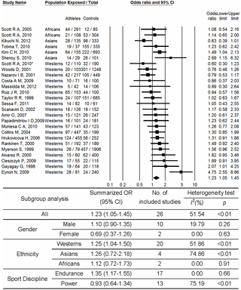
ACE
Ma, F et al. (2013). PLoS ONE 8(1): e54685.

Slide 15
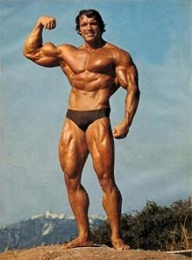

α-actinin-3 (ACTN3) [ie. “speed gene”]
Strength
Endurance
vs
Arnold Schwarzenegger
Dean Karnazes

Slide 16
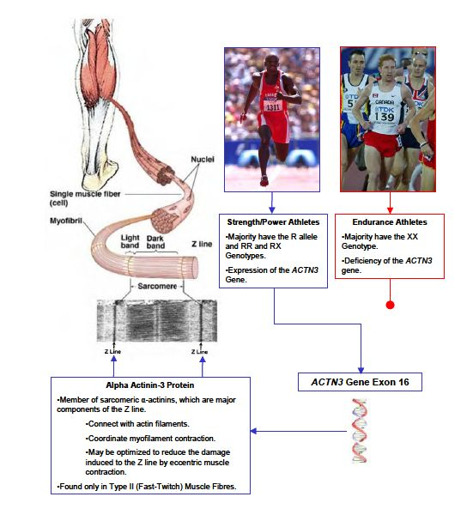
ACTN3
kohlmanngen677s13.weebly.com

Slide 17
ACTN3
- alpha-actinin-3: crosslinks actin thin filaments in type II (fast glycolytic) skeletal muscle fibers; thought to maintain ordered fiber arrays and coordinate contraction
- rs1815739: R577X; C->T; TT = 22% European, 18% Japanese, <1% African
- CC [RR]: 2 functioning copies of ACTN3
genotype associated with increased strength (OR=2.31; p=0.0001)
overrepresented in elite sprint/power athletes
- TT [XX]: 0 functioning copies of ACTN3
genotype associated with increased endurance (OR=1.38; p=0.148)
overrepresented in elite endurance athletes
- explains 2-3% of the population variance in muscle function
- many studies show conflicting results on ACE and athletic performance
Yang (2003) Am J Hum Genet 73: 627-631.

Slide 18
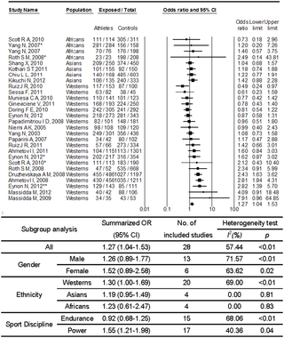
ACTN3
Ma, F et al. (2013). PLoS ONE 8(1): e54685.

Slide 19


ACTN3

Slide 20
Sports Genetics = Performance + Injury

Slide 21
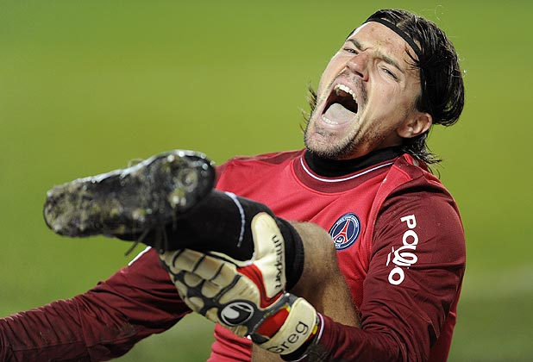
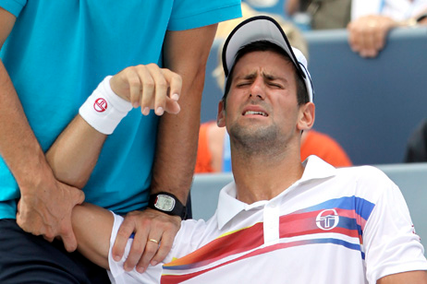

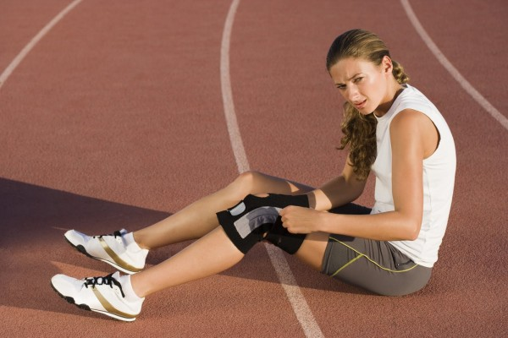
Injuries are common in athletes

Slide 22







Athletes use trial and error to find what works
?

Slide 23

Athletes don’t know their injury risk
?
?
?
?
?
Low
Genetic Injury Risk
High
Training

Slide 24
Knowing injury risk allows optimal training
Low
High
Genetic Injury Risk
Training

Slide 25


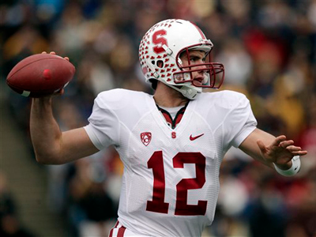
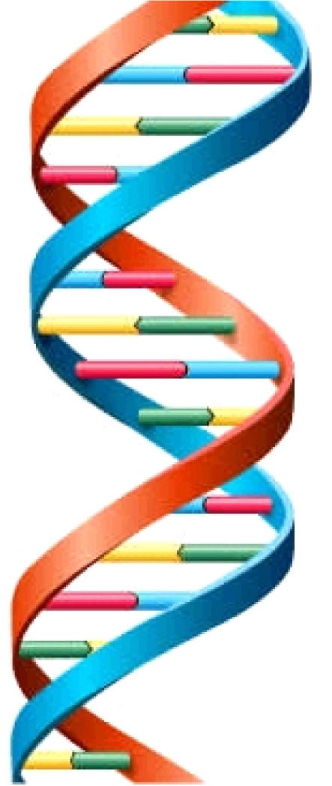
Genetic analysis to optimize training
Athlete
DNA Collection
Genetic Testing
1
1

Slide 26

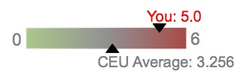
Genetic analysis to optimize training
Genetic analysis can be used to optimize training
Average: 3.256
Data Analysis
Risk Assessment
2

Slide 27
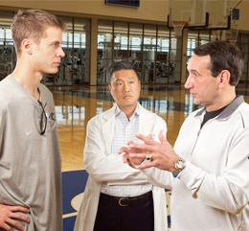
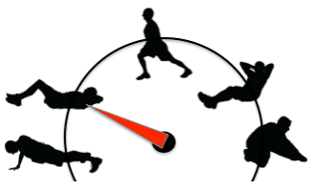
Genetic analysis to optimize training
Genetic analysis can be used to optimize training
Consultation
Optimal Training
3
3

Slide 28
Genetic testing for injury risk
?
Over 200 DNA variations associated with 15 categories:
Bone Metal Density/Stress Fracture
Achilles Tendinopathy
Osteoarthritis
Disc Degeneration
Mineral/Vitamin Deficiencies (7 categories)
ACL Rupture
Asthma/Lung Function
Low Hemoglobin/Blood Disorders
Sickle Cell Trait

Slide 30

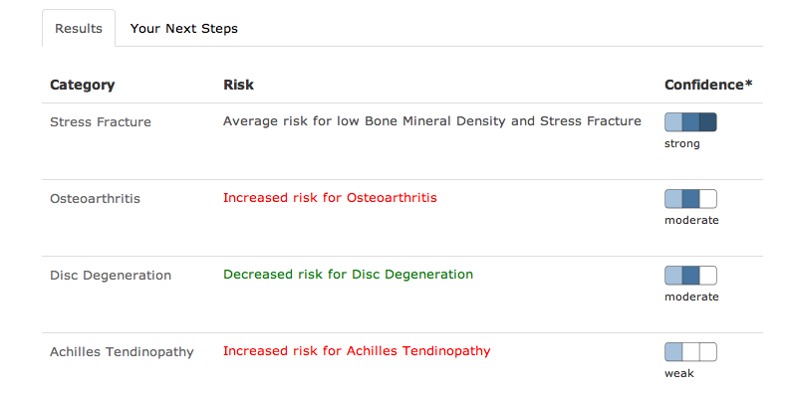
Injury risk profile based on genetics
https://sportsgenetics.stanford.edu

Slide 31
Bone mineral density and stress fracture
https://sportsgenetics.stanford.edu
Notes:
31

Slide 32
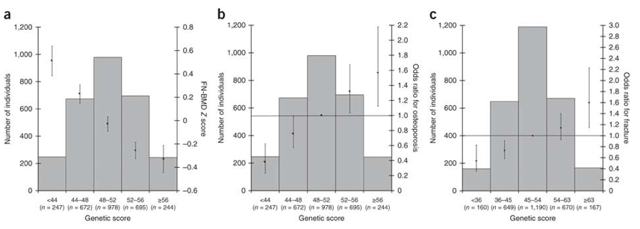
BMD genetic score correlates with fracture odds
Genetic score correlates with stress fracture risk
Low genetic score indicates high bone mineral density
Low genetic score indicates low stress fracture risk
High genetic score indicates high stress fracture risk
High genetic score indicates low bone mineral density
Estrada K, et al (2012) Nat Genet, 44(5): 491-501.

Slide 33

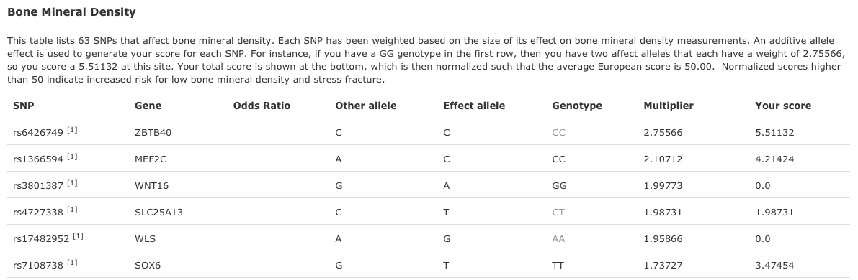
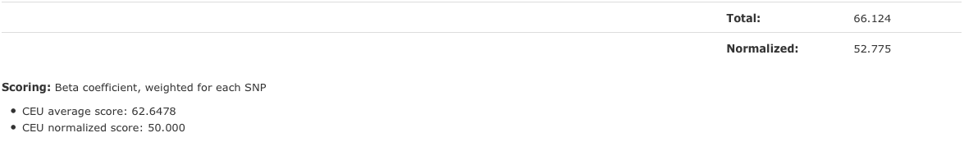
Bone mineral density and stress fracture
63 total SNPs
|
|
|

Slide 34
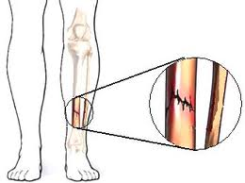
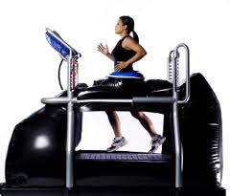

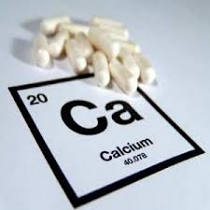
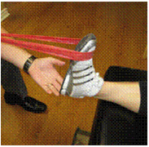
Interventions to decrease stress fracture risk
Interventions can decrease the risk of stress fracture
Stress Fracture - Interventions
1. DEXA Scan
2. Vitamin & Mineral Supplements
3. Strength & Flexibility
4. Low Impact Training
5. Cross Training
6. Biomechanical Movement Evaluation
7. Optimize Footwear
1.
2.
3.
4.

Slide 35
Interventions decrease the injury rate
Interventions decrease injury rates in athletes
Randomized Controlled Trials
Soccer (2013)
72% reduction in injuries
2. Basketball (2012)
68% reduction in injuries
Steffen K, et al (2013) Br J Sports Med 47: 794-802.
Longo U, et al (2012) Am J Sports Med 40: 996–1005.

Slide 36

Pilot Study: Stanford Triathlon Team
Proof of concept: Stanford Triathlon Team

Slide 37
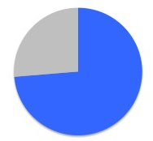
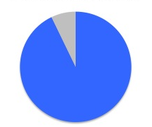

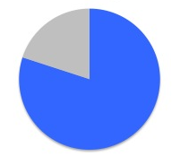
Athletes took action and had a positive outcome
Participated
Valued Genetic Risk Info
74%
93%
Took Action
Reported Positive Impact
71%
80%
Goodlin G, et al (2013) Br J Sports Med. Submitted.

Slide 38
What are the risks of personal genetic testing?
Ethics
  Efficacy: will personalized medicine provide a benefit to patients or athletes?
  Impact: will there be harm to the patient now or in the future?
  Knowledge: can you learn something about yourself you didn’t want to know?
  Science or Snake Oil: are genetic tests for athletic ability a good idea?
  Business Model: direct to consumer companies (23andMe) vs physician referral (Counsyl)
Privacy
  GINA 2008: no one can be discriminated against based on their genetics
  Genetic information is owned by the patient/athlete & they decide who to share it with
Informed Consent
  Education of risks/benefits & explanation of science is essential
  Genetic testing process is 100% voluntary & elective

Slide 39
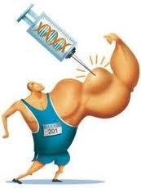
What will the future hold for genetics and personalized medicine in athletics?
- all athletes competing at recreational to elite levels have complicated genetic profiles & environmental histories
many factors influence potential athletic ability
actual performance & success is hard to predict
- genetic engineering ("gene doping") to enhance athletic performance?
will detection ever be able to keep up with "cheating"?
- scientist viewpoint= global perspective on athletes genetics and environment to understand how they interact; filling in the missing heritability for traits
- athlete viewpoint= develop training program to maximize individual genetic endowment for optimal performance
Ostrander (2009) Annu Rev Genomics Hum Genet 10:407-429.

Slide 41
Athletic performance is determined by a combination of factors
- measure: Ironman Triathlon finish times
no significant difference in training time/volume between "fast" and "slow" groups
age + weight explain 14% of variance
COL6A1 genotype (TT vs TC/CC) explains 8% of variance
BDKRB2 +9/+9 & NOS3 GG genotypes associate w/ significantly slower times [p=0.001]
- measure: endurance (VO₂ max + LT) + efficient muscle contraction
ACE-I/BDKRB2-9 haplotype significantly associated in Olympic athletes vs ct's [p=0.003]
- heritability of beneficial endurance traits is ~50% (VO₂ max, RE, LT)
- heritability of athletic status in women is ~66% (recreational vs elite competition)
positive associations for SLC9A9, FABP2, UCP1
- can we identify other factors?
Williams (2004) J. Appl. Physiol. 96:938–42.
Saunders (2006) Hum. Mol. Genet. 15:979–87.
De Moor (2007) Twin Res. Hum. Genet. 10:812–20.

Slide 42
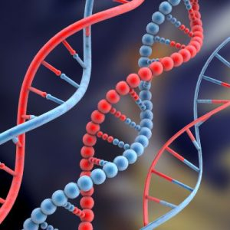
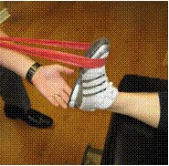
Pilot Study: Stanford Triathlon Team
13 of 14 athletes had no negative impact from learning their genetics
10 of 14 shared their genetic info with doctors, trainers, and coaches (only 1 athlete kept their info private)
10 of 14 athletes took action based on their genetic info (9 of these 10 are still following the interventions they initially adopted)
12 of 14 athletes stated the experience was “very valuable”
8 of 14 athletes believe there has already been or will be a “positive impact” on their health, training, and performance
0 of 14 athletes stopped training or lost motivation to continue in sports

